Slide 1
Regular Expressions

Slide 2
Regular Expression (RE)
Regular expression: An algebraic way to describe regular languages.
Many of today's programming languages use regular expressions to match patterns in strings.
  E.g., awk, flex, lex, java, javascript, perl, python
Used for searching texts in UNIX (vi, Perl, Emacs, grep), Microsoft Word (version 6 and beyond), and WordPerfect.
Few Web search engines may allow the use of Regular Expressions

Slide 3
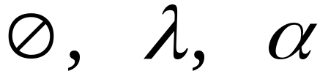



Recursive Definition
Primitive regular expressions:
Given regular expressions and
Are regular expressions

Slide 4
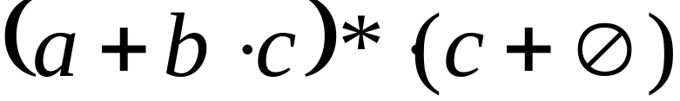
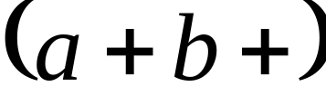
Examples
A regular expression:
Not a regular expression:

Slide 5
Regular Expressions
Operator Precedence:
  Highest: Kleene Closure
  Then: Concatenation
  Lowest: Union
A regular expression:

Slide 6
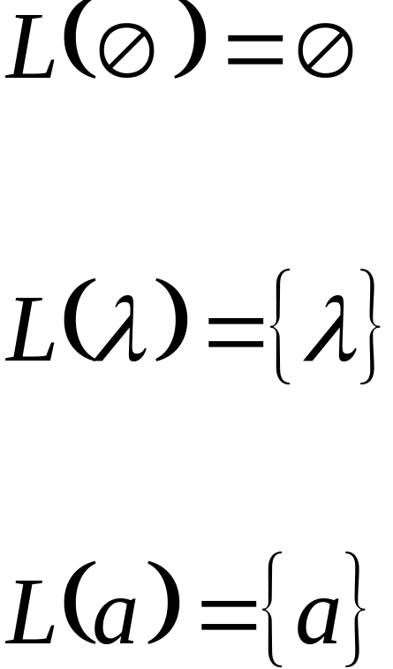
Definition
For primitive regular expressions:

Slide 7


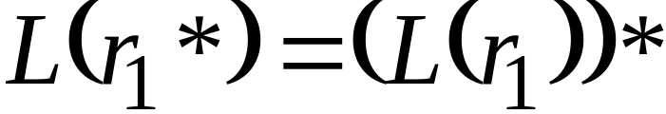

Definition (continued)
For regular expressions and

Slide 8
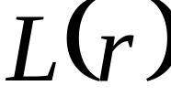

Languages of Regular Expressions
: language of regular expression
Example

Slide 9

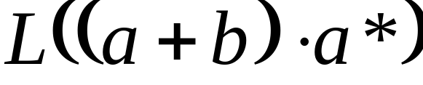


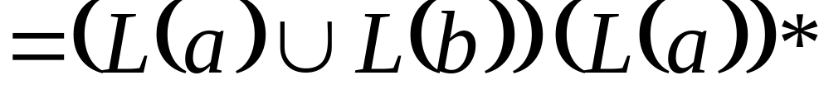
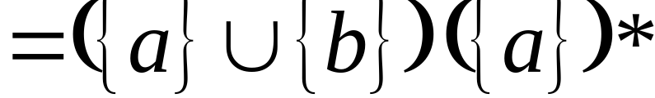
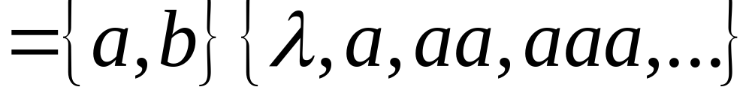
Example
Regular expression:

Slide 10

Example
Regular expression

Slide 11


Example
Regular expression

Slide 12


Example
Regular expression
= { all strings containing substring 00 }

Slide 13
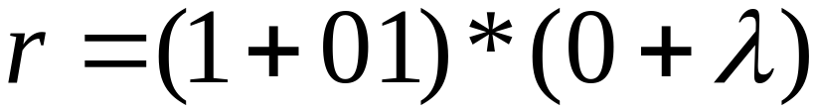
Example
Regular expression
= { all strings without substring 00 }

Slide 14

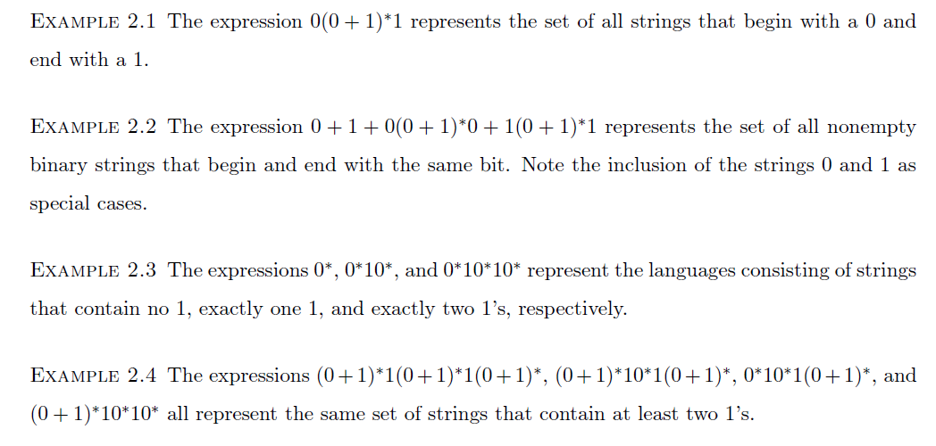
Regular Expressions

Slide 15

Equivalent Regular Expressions
Definition:
Regular expressions and
are equivalent if

Slide 16

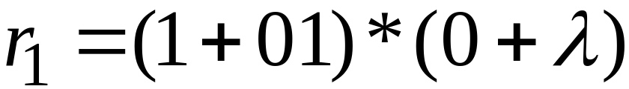

Example
= { all strings without substring 00 }
and
are equivalent
regular expressions

Slide 17
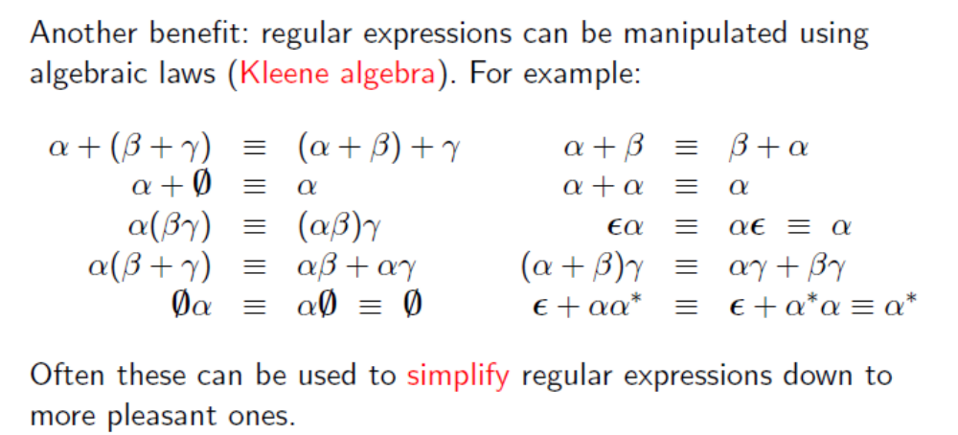
Kleene algebra

Slide 18
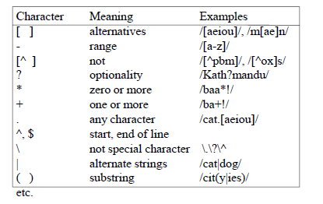
Regular Expression: The IEEE POSIX standard

Slide 19
Regular Expressions
Valid Email Addresses
Valid IP Addresses
Valid Dates
Floating Point Numbers
Variables
Integers
Numeric Values

Slide 20
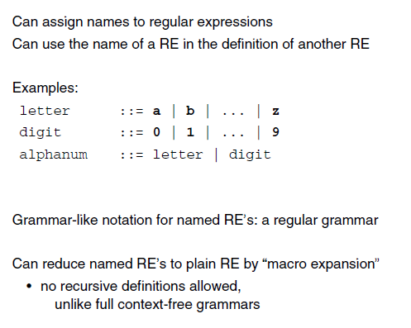
Naming Regular Expressions

Slide 21
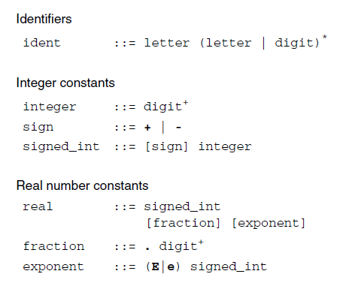
Specifying Tokens

Slide 22
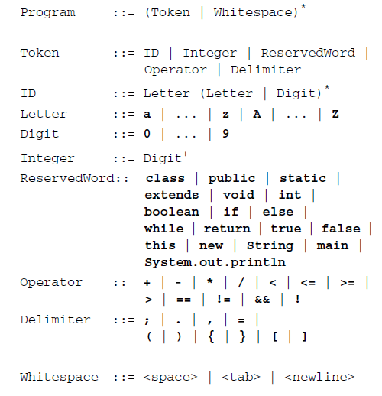
RE specification of initial MiniJava lexical structure

Slide 23
Regular Expressions and
Regular Languages

Slide 24

Theorem
Languages
Generated by
Regular Expressions
Regular
Languages
Theorem (Kleene 1956):

Slide 25
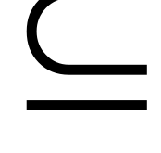

Proof:
Languages
Generated by
Regular Expressions
Regular
Languages
Languages
Generated by
Regular Expressions
Regular
Languages

Slide 26
Proof - Part 1
Languages
Generated by
Regular Expressions
Regular
Languages
For any regular expression
the language is regular
Proof by induction on the size of

Slide 27
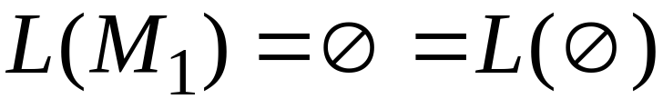
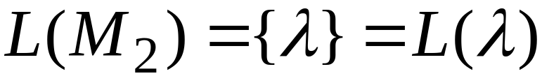

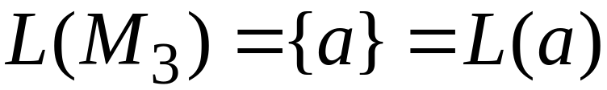
Induction Basis
Primitive Regular Expressions:
Corresponding
NFAs
regular
languages

Slide 28
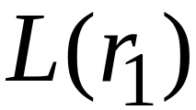
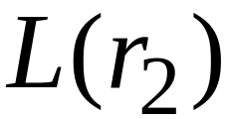
Inductive Hypothesis
Suppose
that for regular expressions and ,
and are regular languages
NFA-1
r₁
NFA-2
r₂

Slide 29
Inductive Step
By inductive hypothesis we know:
and are regular languages
We will prove: There exits NFA for regular expressions

Slide 30
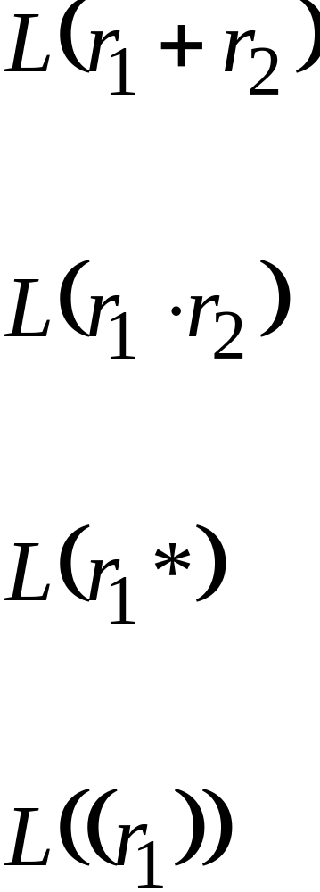
Inductive Step
If we can, then:
Are regular
Languages

Slide 31
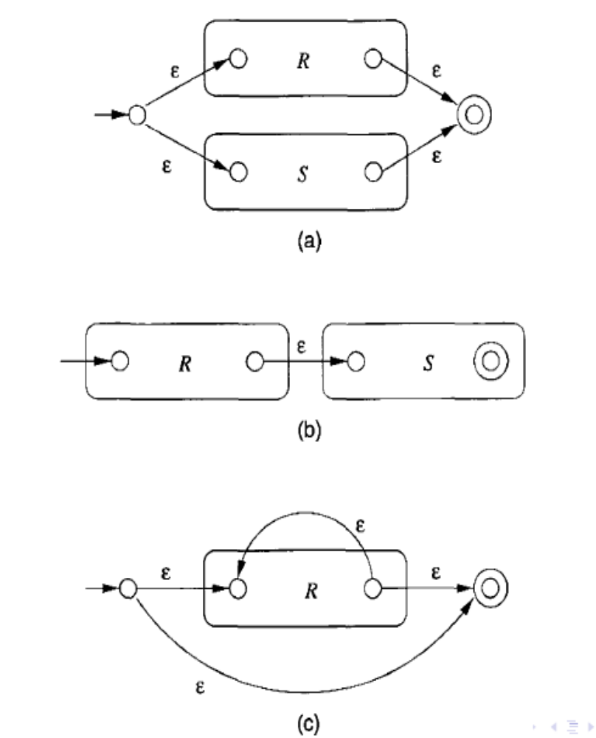
Inductive Step
End of Proof-Part 1

Slide 32
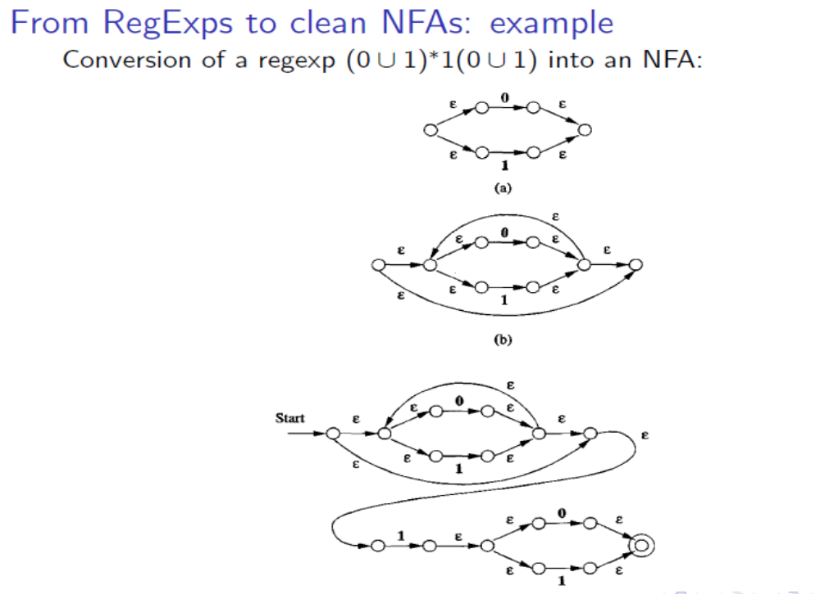
Example

Slide 33
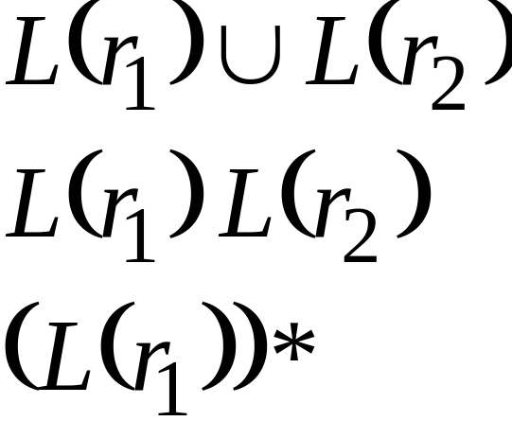
Interesting Properties of Regular languages
Regular languages are closed under:
Union
Concatenation
Star

Slide 34
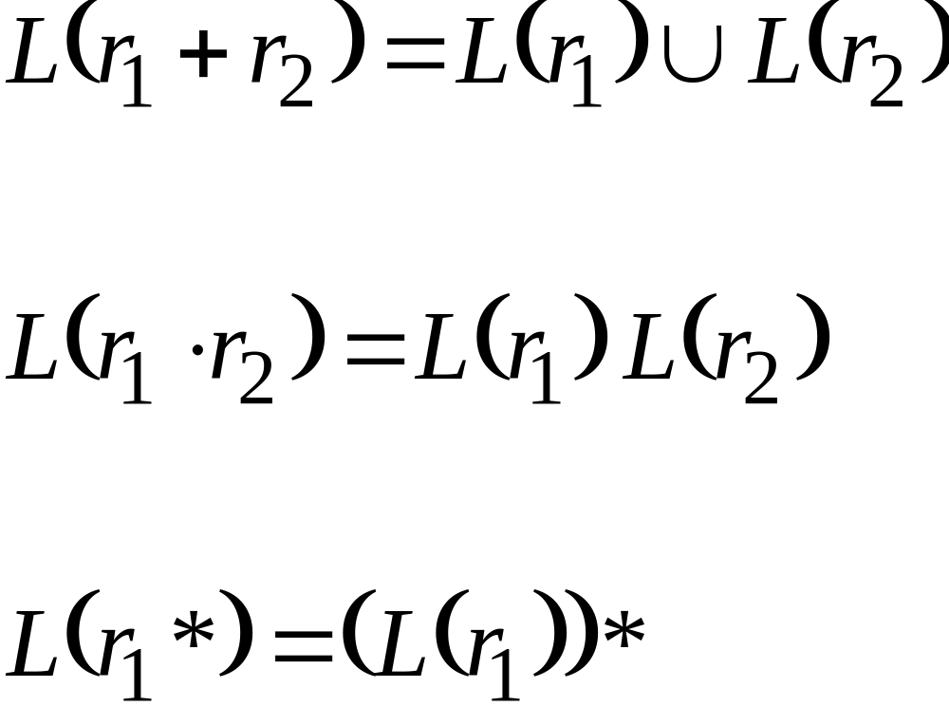
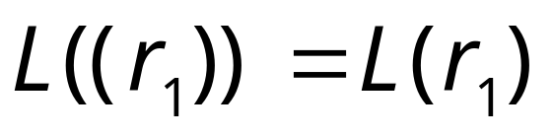
We can prove the closure property
Are regular
languages
is trivially a regular language

Slide 35
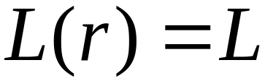
Proof - Part 2
Languages
Generated by
Regular Expressions
Regular
Languages
For any regular language there is
a regular expression with
We will convert an NFA that accepts
to a regular expression

Slide 36
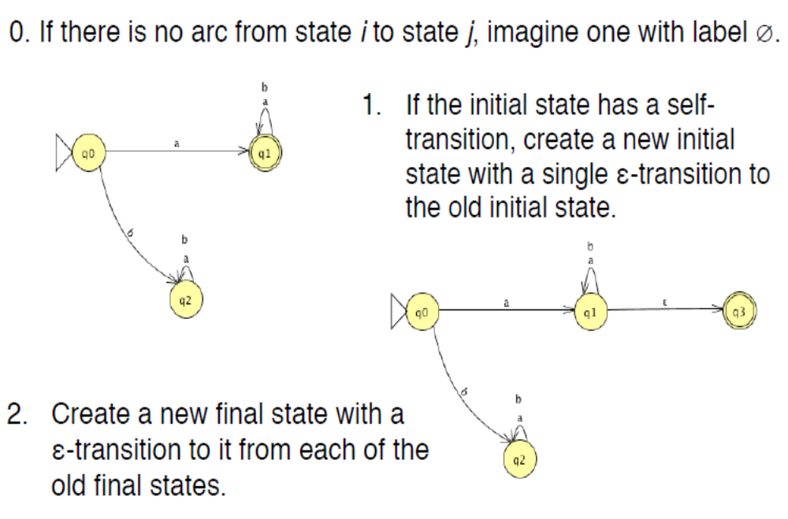
NFA to RE

Slide 37
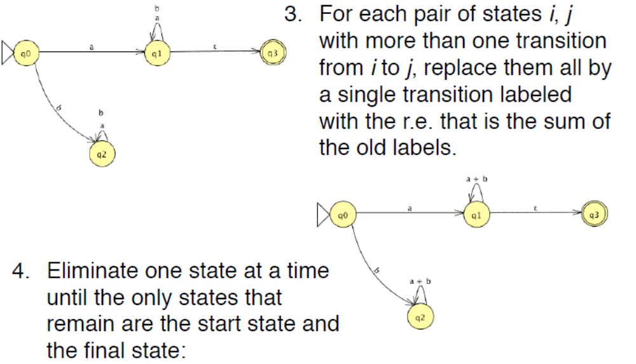
NFA to RE

Slide 38
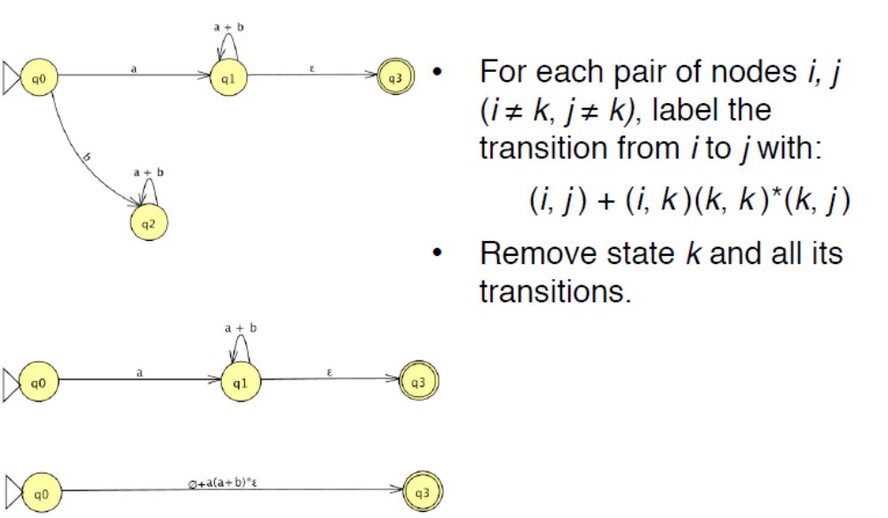
NFA to RE

Slide 39
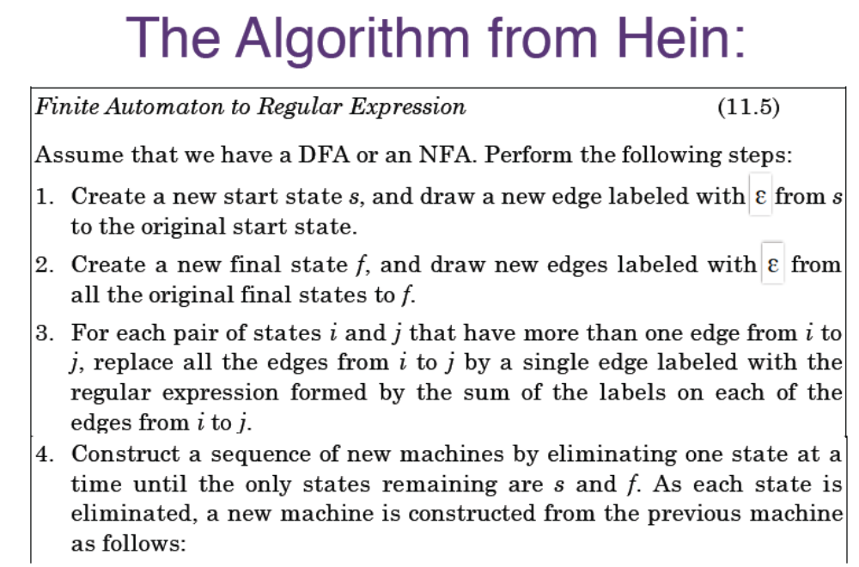
NFA to RE

Slide 40
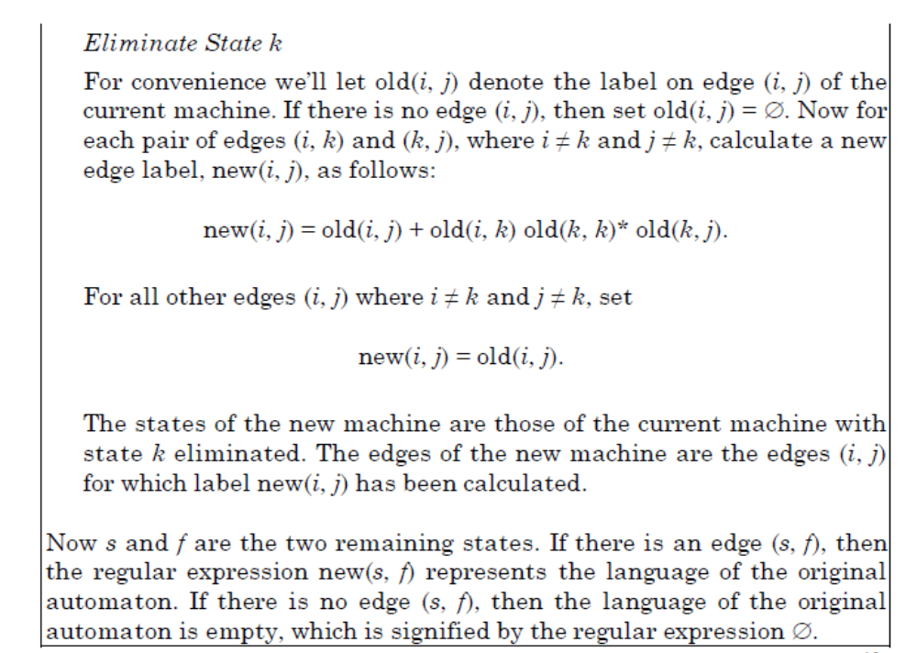
NFA to RE

Slide 41
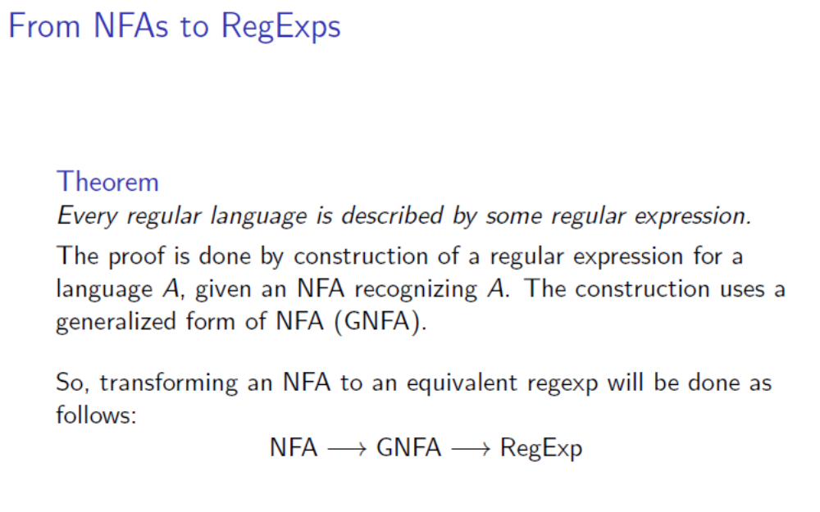
NFA to RE

Slide 42
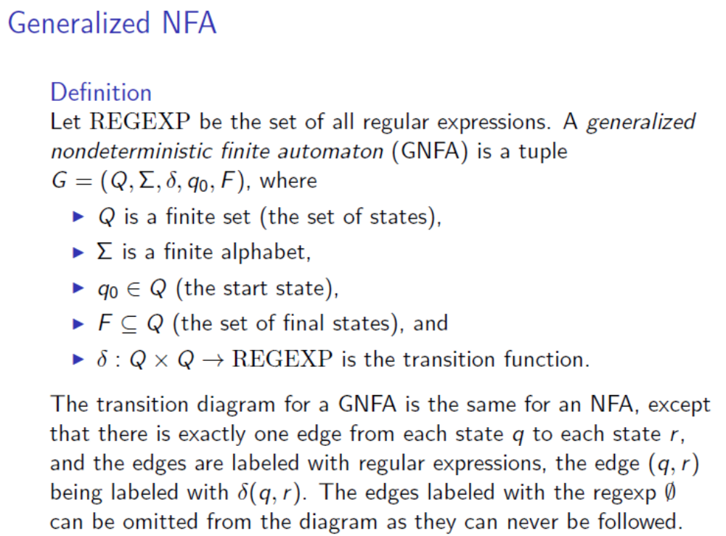
NFA to RE

Slide 43





From construct the equivalent
Generalized Transition Graph
in which transition labels are regular expressions
Example:
Corresponding
Generalized transition graph

Slide 44




Another Example:
Transition labels
are regular
expressions

Slide 45

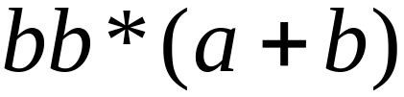
Reducing the states:
Transition labels
are regular
expressions

Slide 46
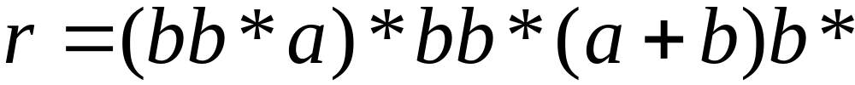
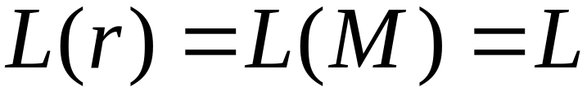
Resulting Regular Expression:

Slide 47









In General
Removing a state:

Slide 48





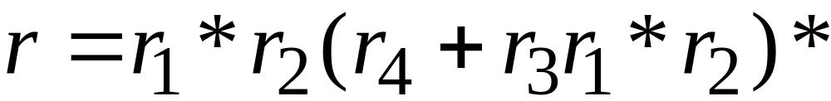
By repeating the process until
two states are left, the resulting graph is
Initial graph
Resulting graph
The resulting regular expression:
End of Proof-Part 2

Slide 49
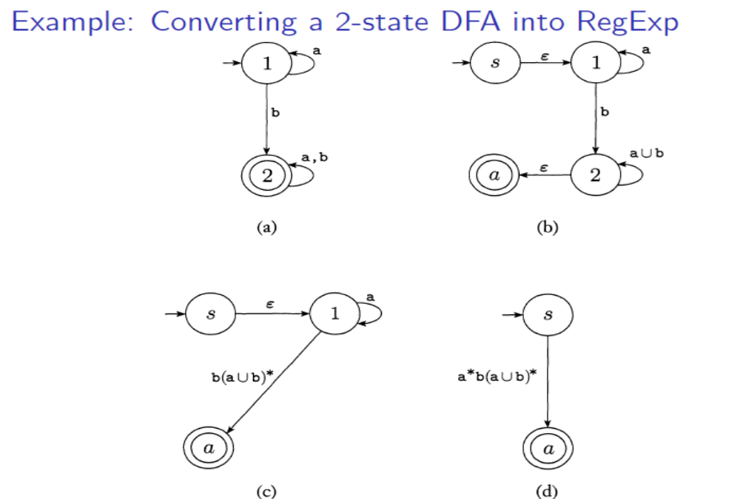
NFA to RE

Slide 50
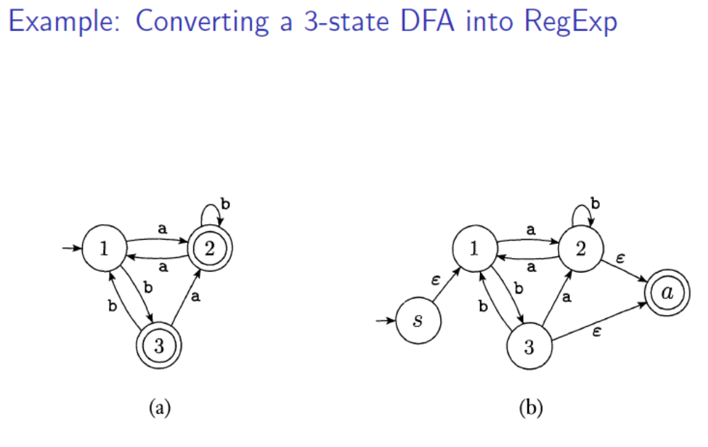
NFA to RE

Slide 51
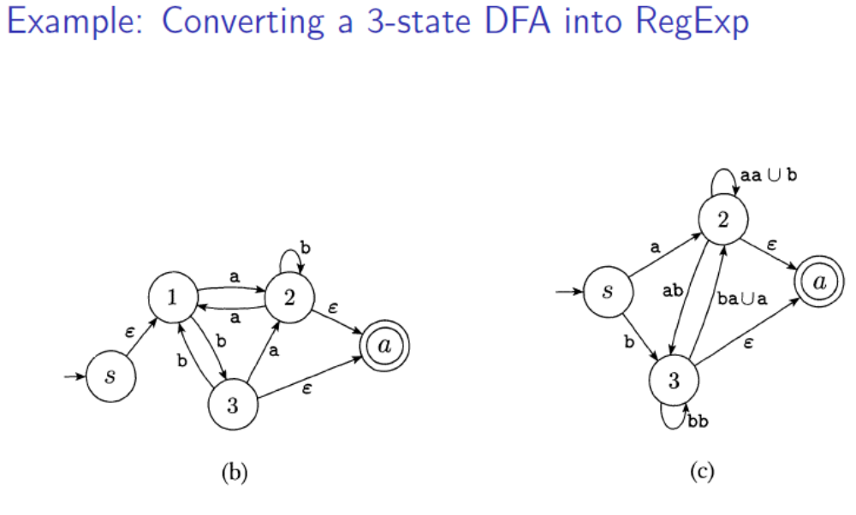
NFA to RE

Slide 52
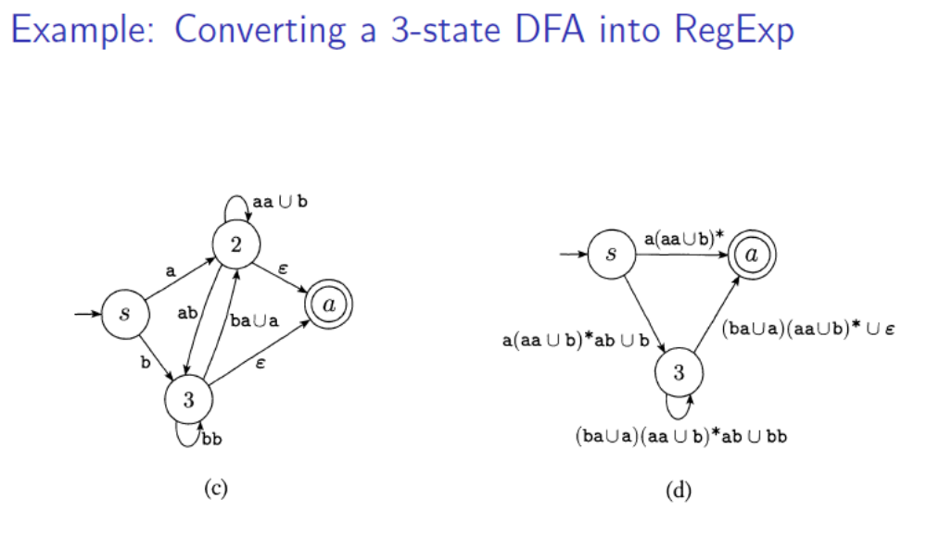
NFA to RE

Slide 53
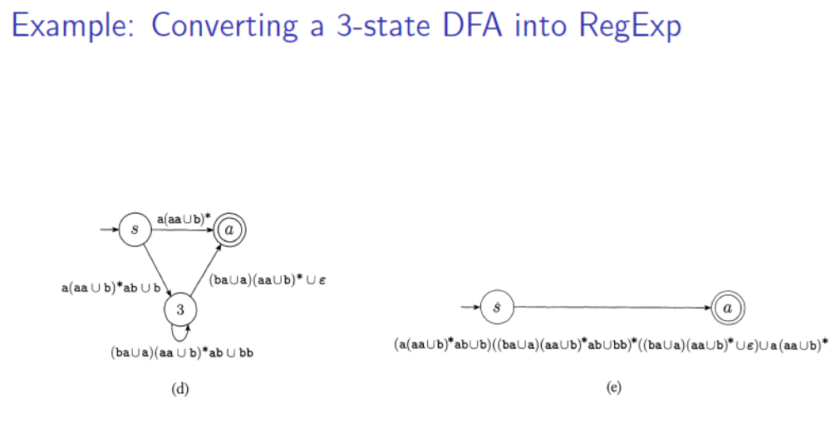
NFA to RE

Slide 54
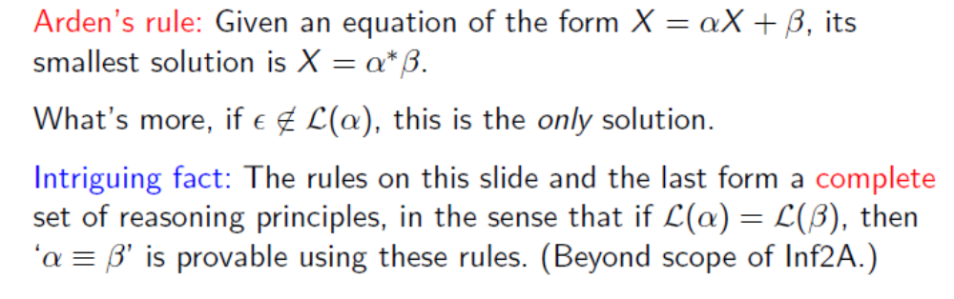
Alternative: NFA to RE

Slide 55
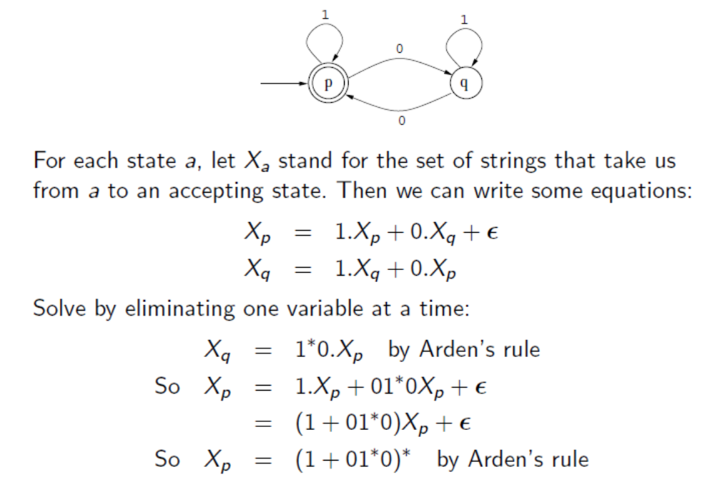
Alternative: NFA to RE
(Final State)

Slide 56
Standard Representations of Regular Languages
Regular Languages
DFAs
Regular
Expressions
NFAs

Slide 57
When we say:
We are given
a Regular Language
We mean:
Language is in a standard
representation
(DFA, NFA, or Regular Expression)

